Slide 1
Pythagoras Finding the Hypotenuse
Year 9 Mathematics

Slide 2
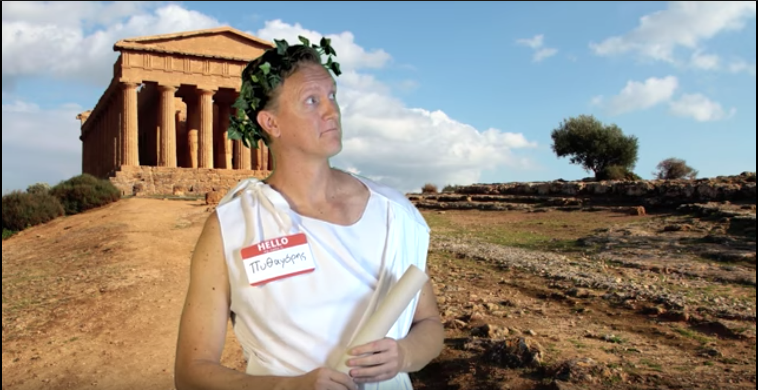
Pythagoras Theorem
https://www.youtube.com/watch?v=WqhlG3Vakw8

Slide 3
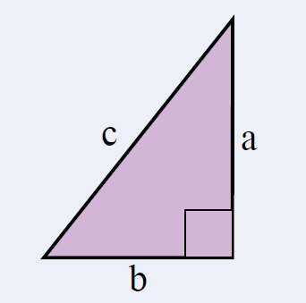

24
7
30
Topic: Pythagoras Theorem
Date: /10/2018
EQ – What is the Pythagoras Theorem?
For any right-angled triangle:
A square made from the length of the hypotenuse is equal to the sum of the squares of the two shorter sides
The hypotenuse is the longest side of a right-angled triangle.
It is opposite the right angle.

Slide 4
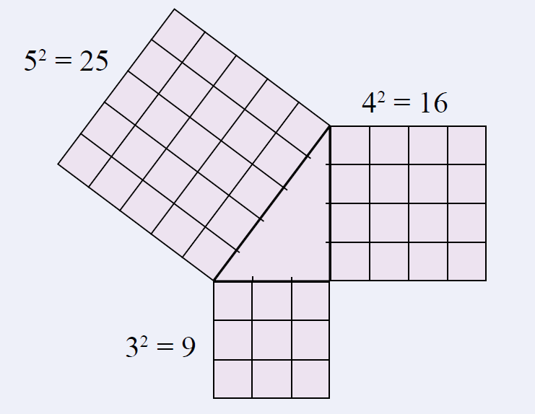
24
7
30
Topic: Pythagoras Theorem
Date: /10/2018
EQ – What is the Pythagoras Theorem?
For any right-angled triangle:
The square on the hypotenuse is equal to the sum of the squares on the other two sides
Example:

Slide 5
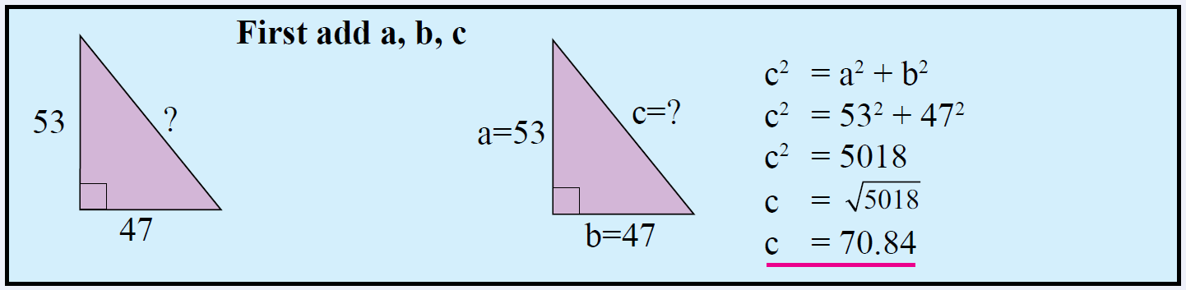

24
7
30
Topic: Pythagoras Theorem
Date: /10/2018
EQ – What is the Pythagoras Theorem?
Worked Example:
Find the length of the hypotenuse in this right-angled triangle.
How do we find the length of the hypotenuse?

Slide 6

We Do
What side is the hypotenuse?
Determine the length of the hypotenuse.
Answers
The hypotenuse is side f.
d = 12cm
$$f^{2}=d^{2}+e^{2}$$
$$f^{2}={12}^{2}+5^{2}$$
$$f^{2}=144+25$$
$$f^{2}=169$$
$$f=\sqrt{169}$$
$f=13$ cm
e = 5cm
f

Slide 7


